Slide 1
CSE315:Introduction to Data Science
WEEK-2

Slide 2
What is Data?
The number of people who are not familiar with the term data is probably very low at present. In fact, the world is running on data, although data is not something that can be touched. Data is a small piece of information. Information is created by combining multiple data.
“Data are symbols that represent properties of objects, events and their environments. They are products of observation” - Ackoff, Russell L

Slide 3
What is Data?
Data is a fact or figure, a small part of a measure is special. Data is a messy raw material, which is processed to create information.
The first use of the word data in English was in 1640. Data is basically a plural Latin word, the singular being Datum.

Slide 4

Information Extraction

Slide 5
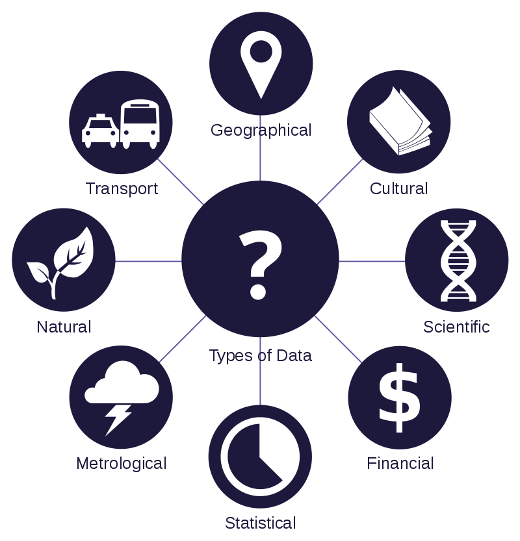
Data Sources

Slide 6
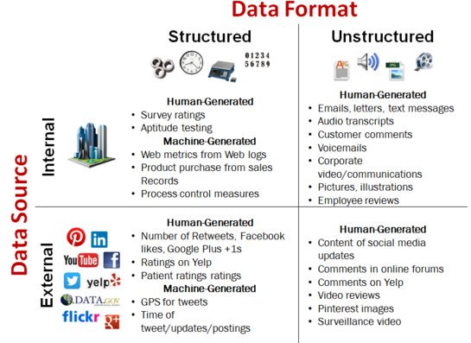
Data Format

Slide 7
DIKW Pyramid
DIKW is an acronym for Data, Information, Knowledge & Wisdom. This pyramid shows how small data can play a role in decision making.
The DIKW pyramid is the continuum of the relationship from data to information, from knowledge to knowledge and from knowledge to wisdom.

Slide 8
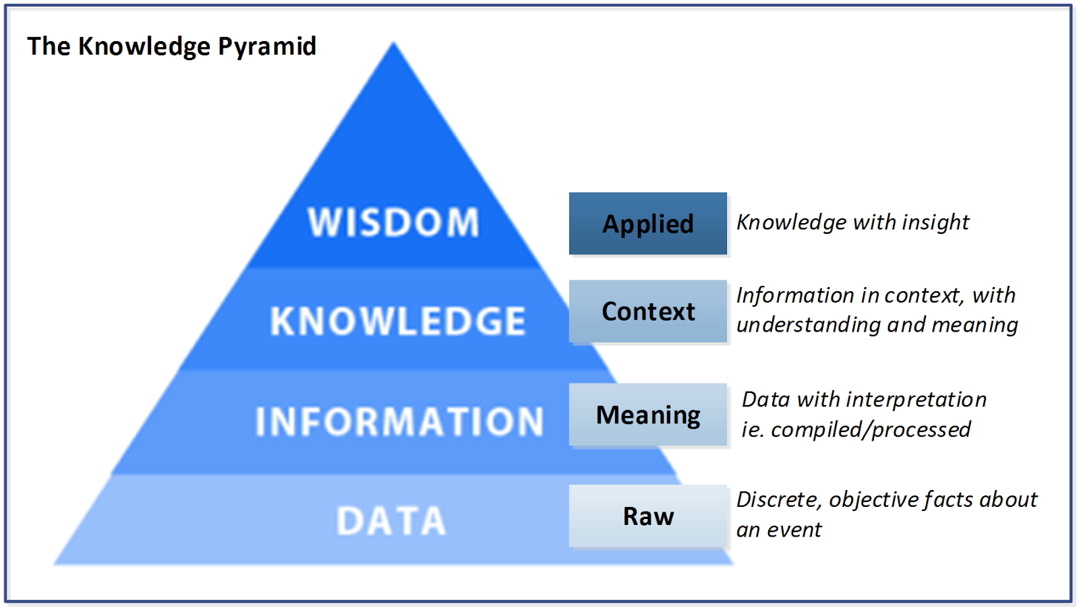
DIKW Pyramid

Slide 9
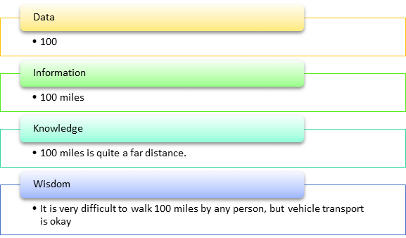
Data to Wishdom

Slide 10
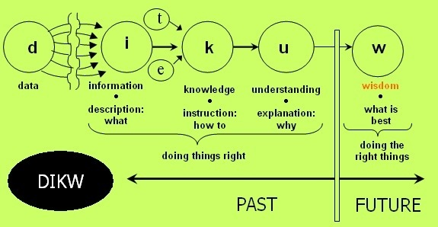
Decision Making from Data

Slide 11
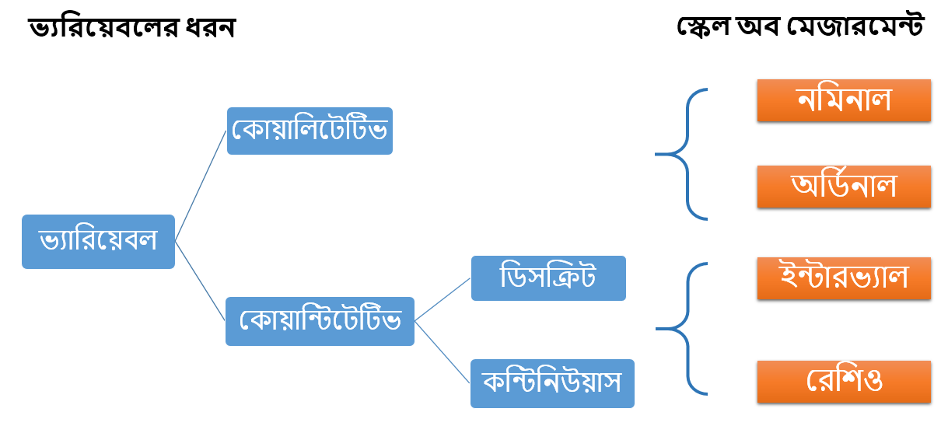
Types of Data

Slide 12
Quantitative Variable
Quantitative- Quantitative Variable is basically a measurement or number based variable. Quantitative variables are also called numerical variables.
Example: age (10 years, 26 years), weight (60 kg, 33 pounds), height (4 feet, 11 inches), distance (11 kilometers, 23 miles), etc. Such variables are expressed by numbers. 0

Slide 13
Types of Quantitative Variable
Quantitative variables can be divided into two classes.
Discrete- Discrete are integer numbers like 15 people, 5 cars etc. Such data can be counted or counted.
For example, you can calculate how many people live in a house, and the number of people must be a whole number, that is, a house can have 4 people, 5 people, etc., but never 2.8 people, 3.5 people or Such a number does not live because the number of people is not possible in the form of fractions.

Slide 14
Types of Quantitative Variable
Continuous- Continuous is the fractional size of the data.
Example: human height 5 feet 4 inches is a fractional number. If you measure the height of the same person on a millimeter scale, you will get a few more millimeter fractions with 5 feet 4 inches.

Slide 15
Qualitative Variable
Qualitative - Qualitative variable contains qualitative or characteristic data. Qualitative variables are also called categorical variables. Such as human hair color, gender, name, name of different places etc.

Slide 16
Scale of Measurement
We can determine the scale of measurement based on the type of data that a variable contains, this scale of measurement is the nature of the data.
- Nominal
- Ordinal
- Interval
- Ratio

Slide 17
Nominal Data
Nominal - Nominal scale can only be divided by category. Many people also call it simply 'label'.
For example, the gender of a person, the color of something, the name of a person, object or place, etc. It is possible to count only on the nominal scale

Slide 18
Ordinal Data
Ordinal - Ordinal scale contains orders. When it is possible to order any nominal data, it can be called ordinal.
For example, a review of a restaurant's food (very good, good, fair, bad, very bad) is an ordinal scale, because if someone gives a 'very good' review, then on this scale it means the biggest while giving a 'very bad' review. Refers to small. If you think about the nominal scale, you can't order a person's hair color (white, black, gold), that's the difference between a nominal and an ordinal scale.

Slide 19
Interval Data
Interval - The interval scale contains a certain distance or difference between data orders. This means that in addition to having all the features of the ordinal, this scale also has another feature called 'fixed distance'.
An excellent example of this scale is the thermometer. Suppose the difference between the scales of a thermometer is 10 degrees Celsius then its clocks will be 0, 10, 20, 30, 40, 50, 60, 60, 60, 90, 100,110 etc. There is a certain distance or difference between these orders, the difference between each order is 10 degrees. This is the interval scale.

Slide 20
Ratio Data
Ratio - The biggest feature of the ratio scale is "Absolute Zero". Now the question is what is Absolute Zero?
To answer this question we will use temperature measurement as an example. If you are asked, does 0 or zero degree temperature mean that there is no temperature? The answer is that even at a temperature of 0 or zero degrees the temperature remains the same because the measurement of temperature on the temperature scale can be minus. So even if the thermometer has a temperature of 0 degrees, you can't say there is no temperature! So there is no absolute zero in temperature measurement. Absolute zero is true emptiness, meaning zero is nothing.

Slide 21
Operations in Data
 | Nominal | Ordinal | Interval | Ratio
Count | √ | √ | √ | √
Mode | √ | √ | √ | √
Order |  | √ | √ | √
Median |  | √ | √ | √
Mean |  |  | √ | √
Add or Subtract |  |  | √ | √
Multiplication or Division |  |  |  | √
Absolute Zero |  |  |  | √

Slide 22
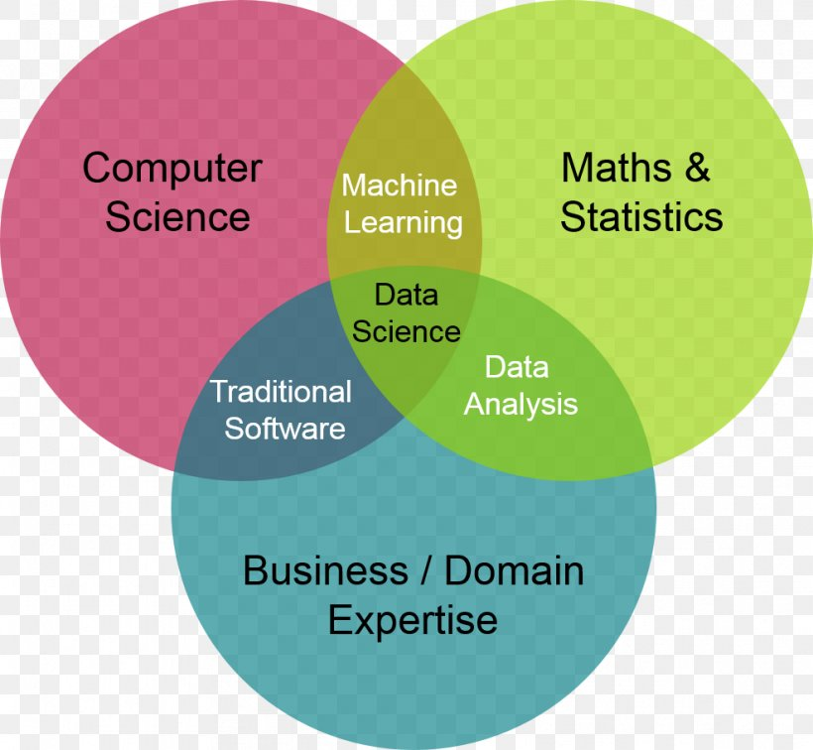
Data Science Venn Diagram
Data science is the science of transformation of data into actionable insights

Slide 23
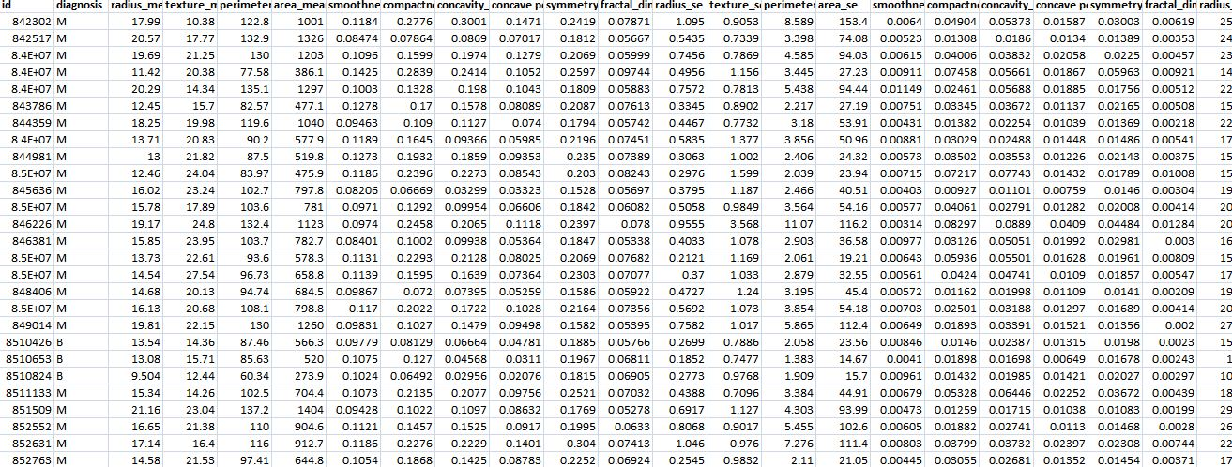
Different mysteries and Different patterns
Medical Dataset: Malignant or Benign
What do you understand from this data set?
What kind of data is inside? What is Insights? Is there a pattern?
The work of data science is to extract various information inside it.

Slide 24
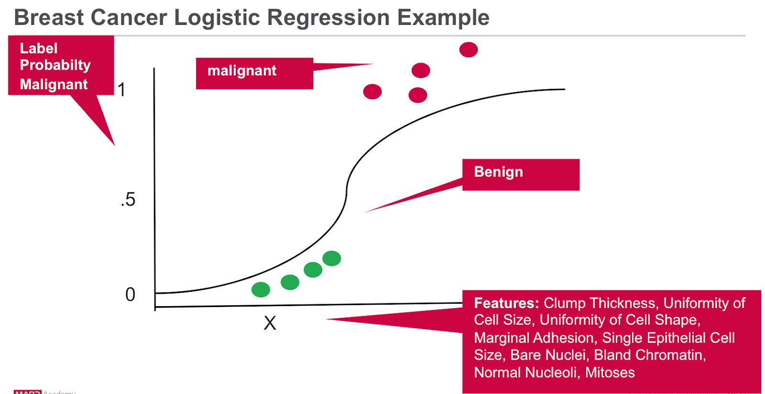
Data Representation

Slide 25
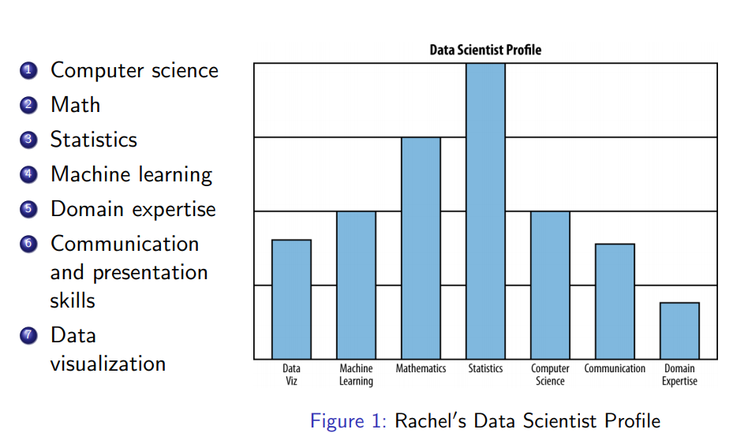
Data Scientist’s Profile

Slide 26
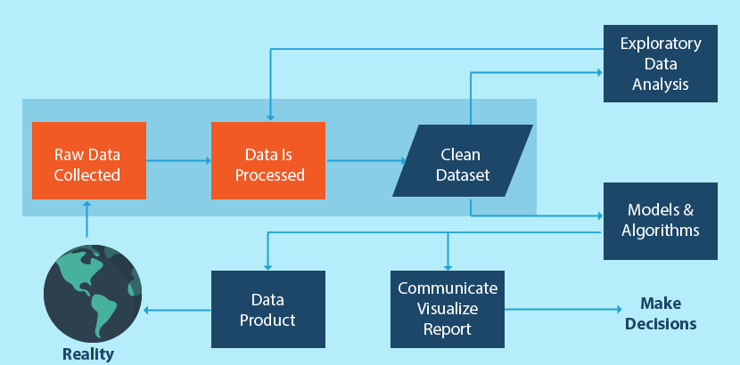
Data Science Pipeline

Slide 27
Domain Knowledge
The first step in the data science process is to know what we are going to do, that is, to determine what output or result we want to get from a data science project. In the case of data science project, the first step is to know what output the user wants through this project.

Slide 28
Domain Knowledge
Another important factor in understanding the needs of the user is business understanding and domain knowledge. It is very important to know where the data we are going to work with comes from in the real world.
That is, the process by which data is generated, how data measurement is done, ideas about all the attributes or features of data, etc. That is, the complete real-world approach to data and the idea of ​​each feature is called Business Understanding and Domain Knowledge.

Slide 29
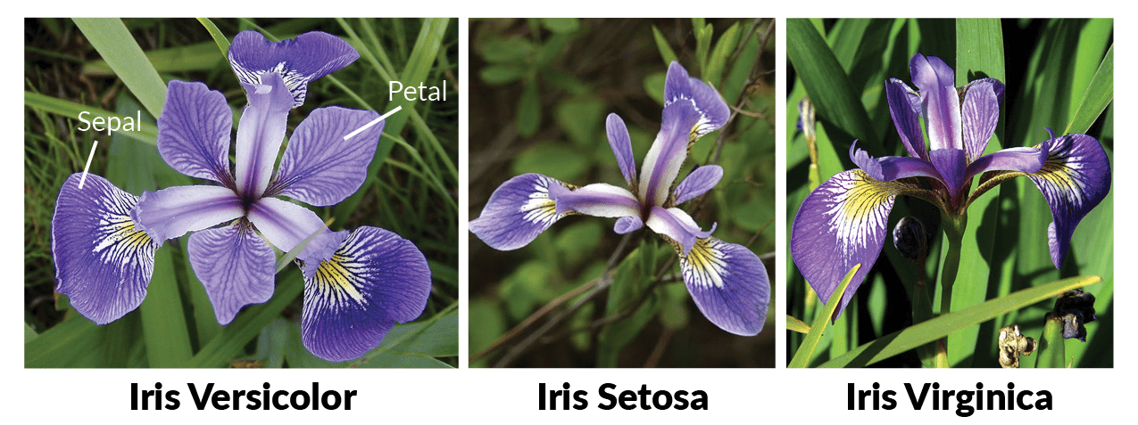
Example of IRIS Dataset
We will clarify the concept of data science goals and domain knowledge through the world famous Iris data set. The father of the Iris data set is the statistician and biologist R.A. Fisher. Iris is the name of a flower. Iris Data Set is also called Iris Flower Data Set. Scientist R.A. Fisher published this data set in 1936.

Slide 30
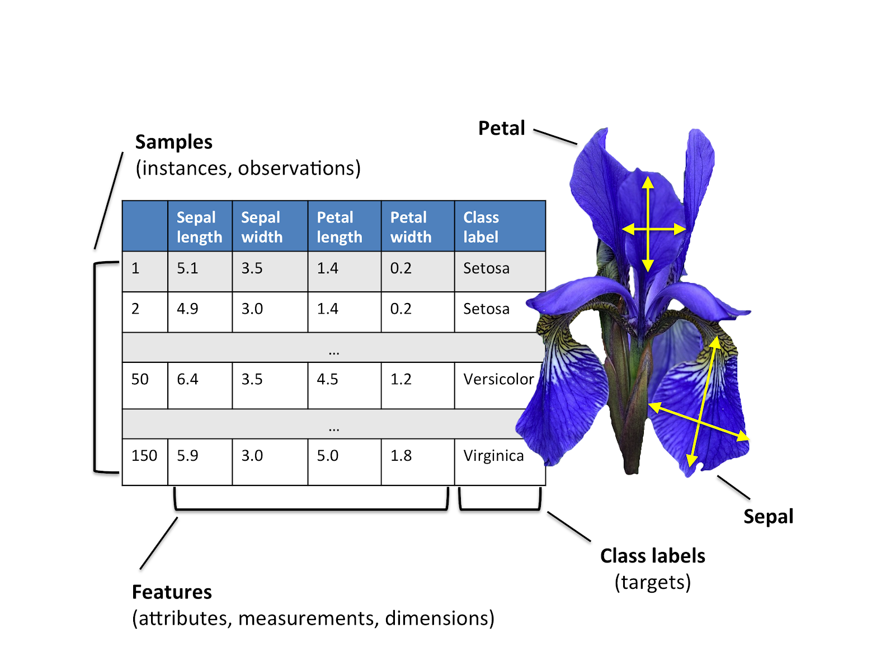
Class Types and Attributes of IRIS Dataset

